Slide 1

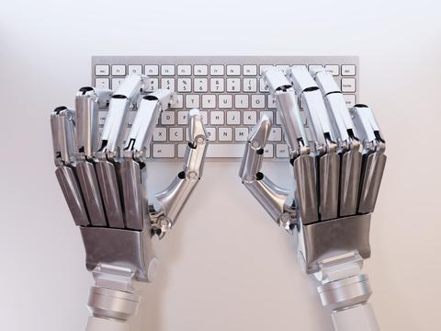



Slide 2
Fundamental Skill Development Program on Python for Machine Learning
( 22-01-2018 to 31-01-2018)
Day | Deliverable
D1 | Basic Concepts of Brain , What is Artificial Intelligence? What is Machine Learning? Machine Learning Life Cycle, Types of Machine Learning? Different editors/Distribution and installation of Python , Simple programs in Python
D2 | Python Basics, Variables, expressions and statements . Conditional execution, Functions and Iteration .
D3 | Strings, Files, Lists, Dictionaries and Tuples Data Structures, Regular Expressions and Exception Handling.
D4 | Object Oriented Programming with Python. Classes and objects, Classes and functions, Classes and methods Using databases and SQL
D5 | Networked programs, Using Web Services Python for Data Analysis Numpy
D6 | Pandas
D7 | Python for Data Visualization : Matplotlib , Seaborn
D8 | Programming Simple Machine Learning Algorithms using Python

Slide 3
Introduction to Artificial Intelligence and Machine Learning:
Facts about Brain and Neuron
What is Intelligence?
What is Artificial Intelligence?
What is Machine Learning?
Machine Learning Life Cycle.
Types of Machine Learning.

Slide 4
Basic Facts about Brain and Neuron

Slide 5
BRAIN
The brain which weighs 1.2 kg to 1.4 kg is the center of nervous system which is made up of 100 billion neurons.

Slide 6
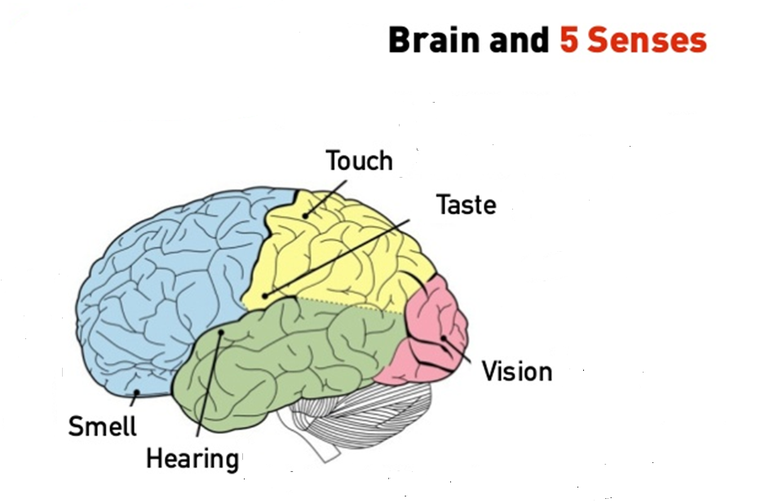

Slide 7
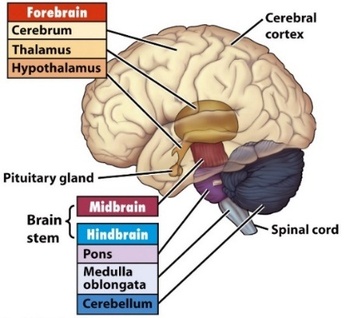

Slide 8
Brain Parts | Sub Parts | Functions
Hind Brain | Medulla Oblongata | Breathing , Heart Rate and BP
 | Pons | Sleep / Dream
 | Cerebellum | Posture / Equilibrium of body , Stores memory of movement pattern (Walk , Dance or Ride Cycle )
Mid Brain | Special Reflexes and Visual and auditory emotion are found here . Reticular activity system. | Alert and Active
Pituitary gland | It secretes hormones from both the front part (anterior) and the back part (posterior) of the gland. Hormones are chemicals that carry messages from one cell to another through your bloodstream
Forebrain (Cognitive , Emotional and Motor Activities) | Hypothalamus | Emotion / motivation ( Eating , Drinking , Sleeping , Temperature ,etc.) HR , BP
 | Thalamus | Senses a signals coming from the sense organ and sends them to appropriate parts of cortex
 | Limbic System | Long term memory
 | Cerebrum | Attention , perception , learning memory and problem solving.
 | Cerebral Cortex | The cerebral cortex is the thin layer of the brain that covers the outer portion (1.5mm to 5mm) of the cerebrum. It is covered by the meninges and often referred to as gray matter. The cerebral cortex is the largest region of the cerebrum and plays a key role in memory, attention, perception, cognition, awareness, thought, language, and consciousness.

Slide 9
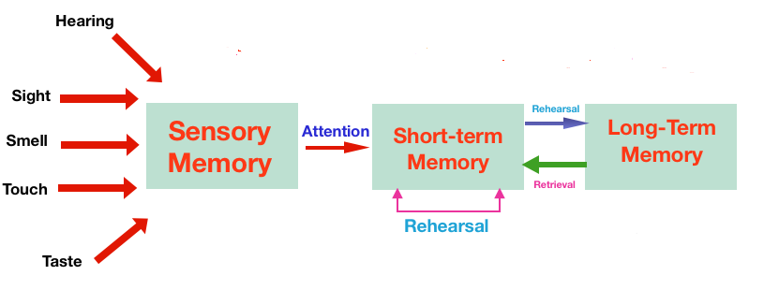
Human Memory Model

Slide 10
Neuron
Neurons are nerve cells that transmit signals or “messages” throughout the body.

Slide 11
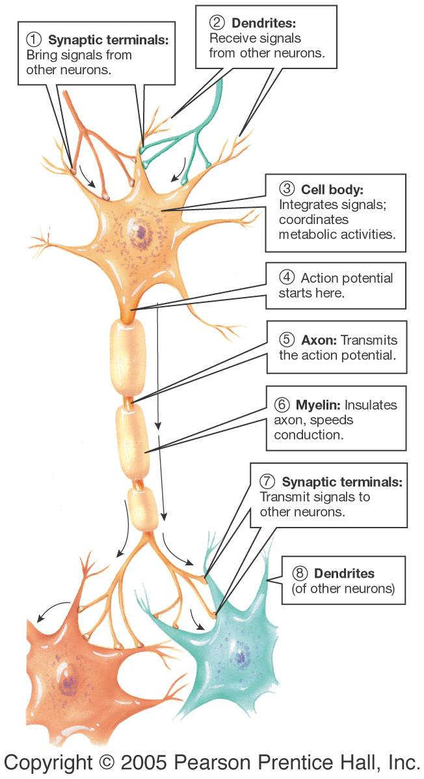
The Structure of Neuron
Dendrites receive signals.
The cell body integrates signals.
The axon transmits action potential. The myelin sheath makes the signal travel faster.
Synaptic terminals transmit signals.

Slide 12
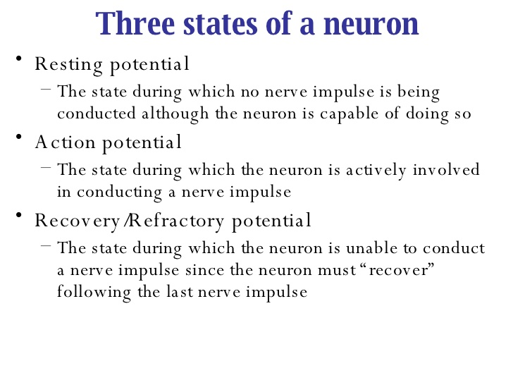

Slide 13
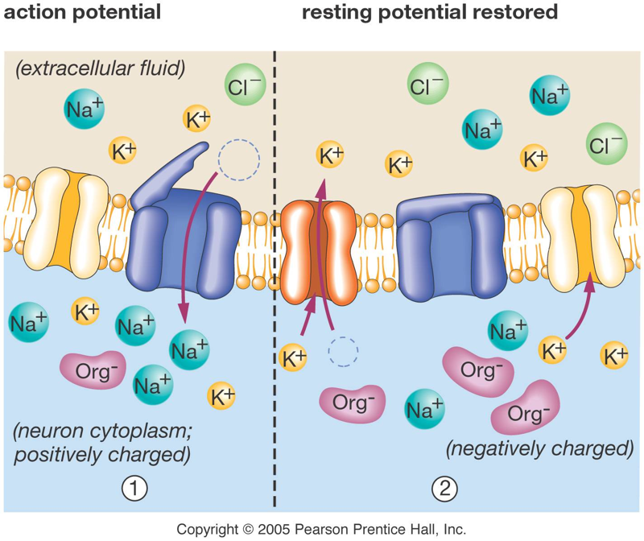

Slide 14
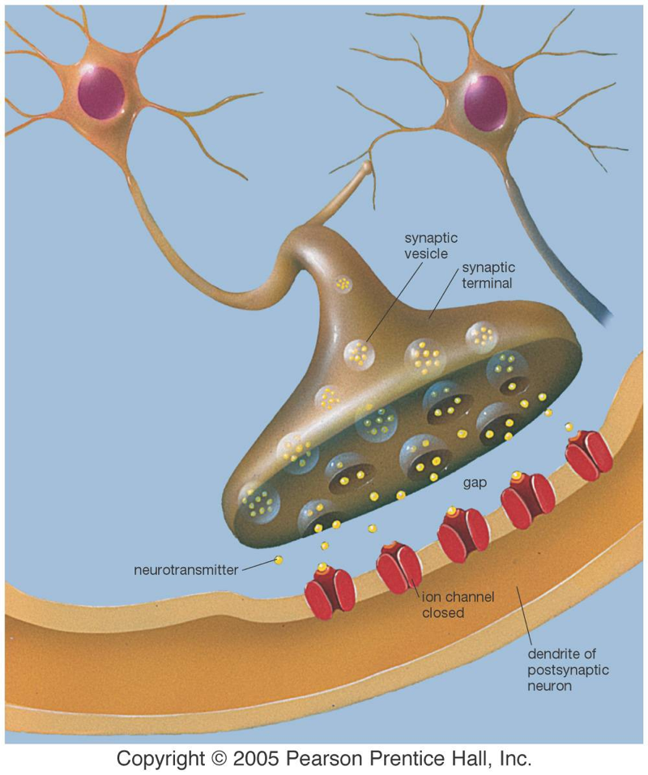
Synapse
Neurons usually do not connect directly to one another. A gap called a synapse controls the transmission of signals.
Neurotransmitters cross the synapse and stimulate the next neuron.

Slide 15
Some Neurotransmitters
Neurotransmitter | Location | Some Functions
Acetylcholine | Neuron-to-muscle synapse | Activates muscles
Dopamine | Mid-brain | Control of movement
Epinephrine | Sympathetic system | Stress response
Serotonin | Midbrain, pons, medulla | Mood, sleep
Endorphins | Brain, spine | Mood, pain reduction
Nitric Oxide | Brain | Memory storage

Slide 16
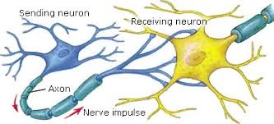

Slide 17
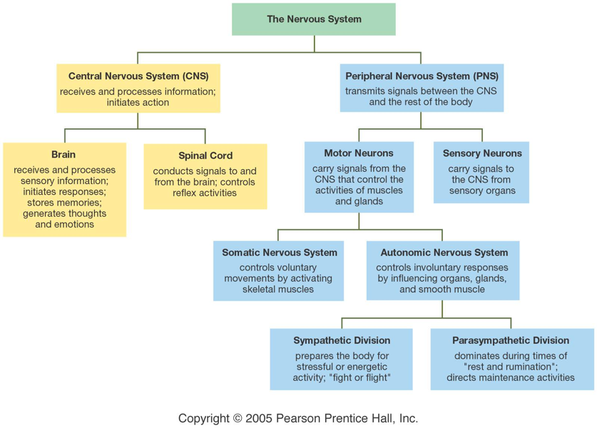
Neural Organization

Slide 18
What is Intelligence ?
Intelligence is a mental capability that involves the ability to understand reason, plan, solve problems, think abstractly, comprehend complex ideas, learn quickly and learn from experience.

Slide 19
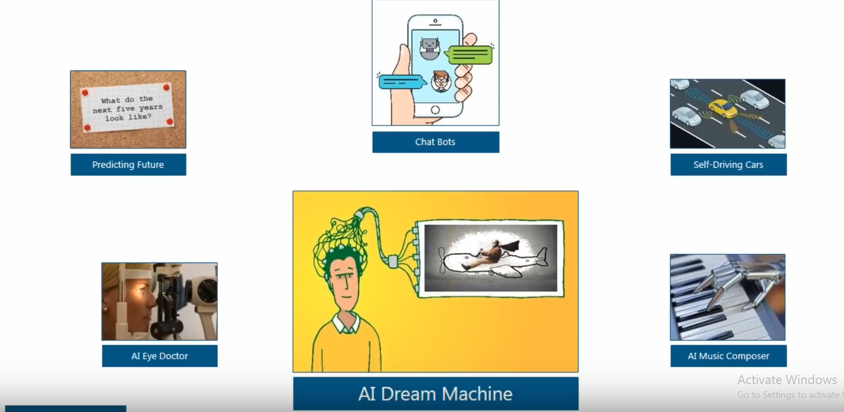
Applications of AI?

Slide 20

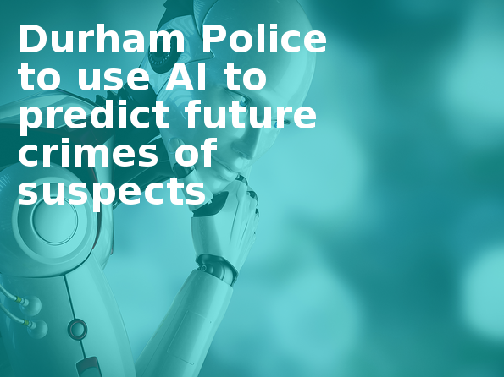
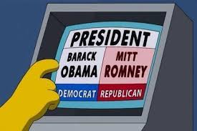
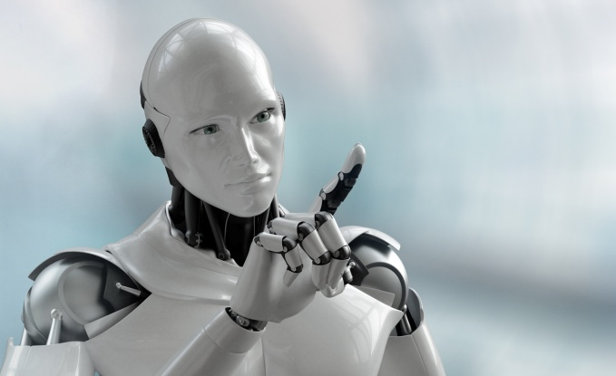
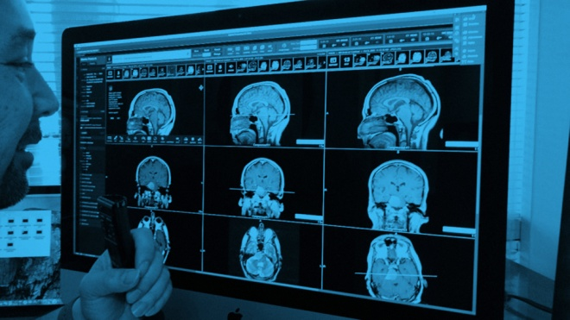
Predicting the Future

Slide 21
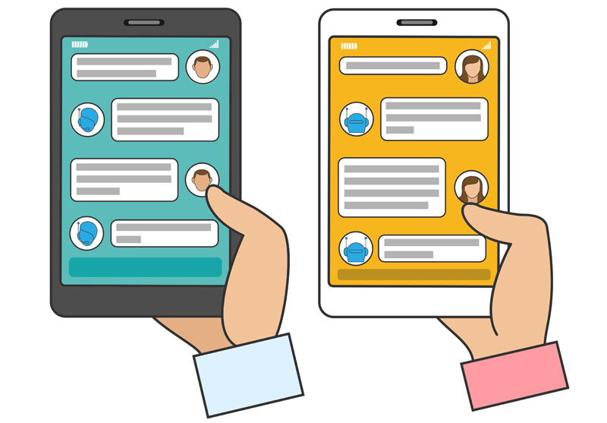
Chatbots

Slide 22
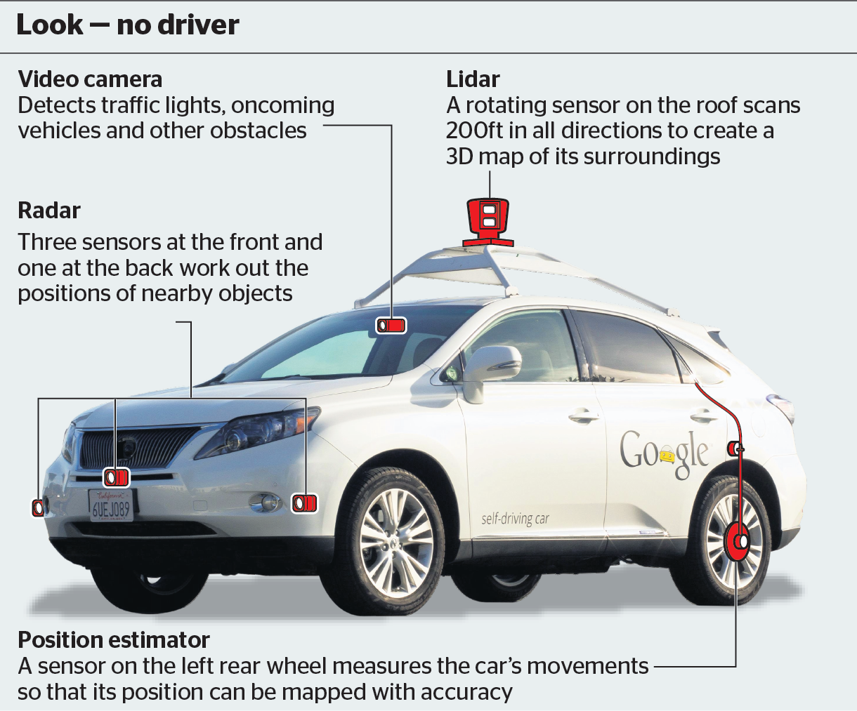
Self Driving Car

Slide 23
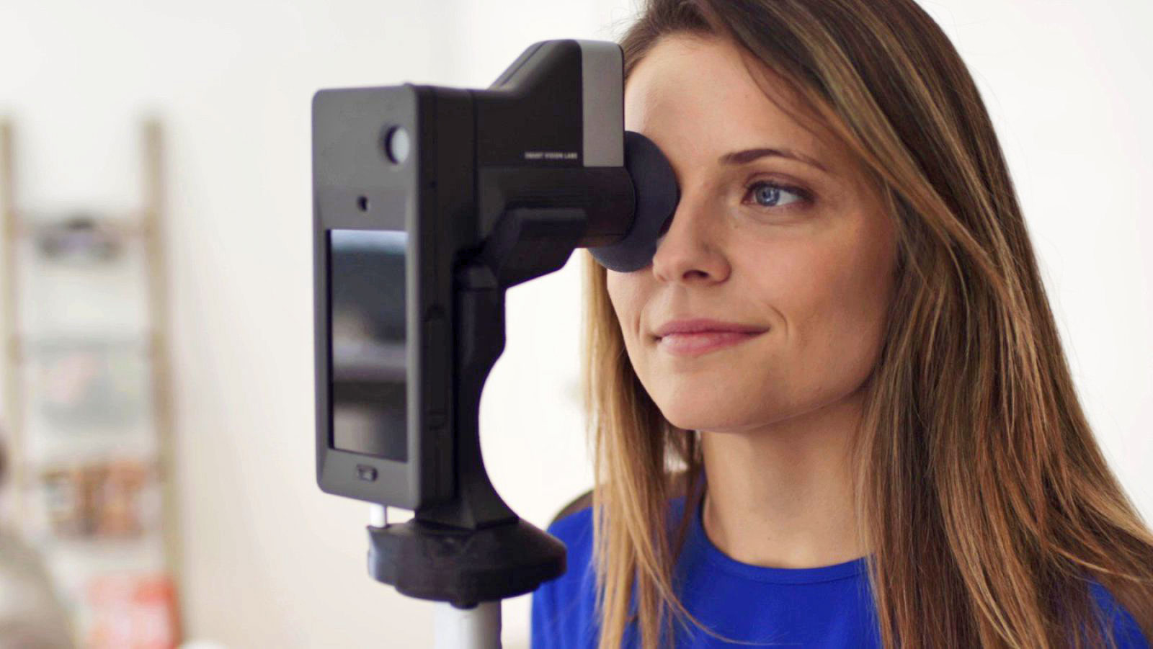
AI Eye Doctor

Slide 24
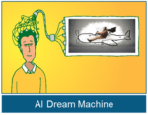
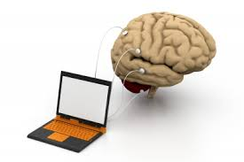
AI Dream Machine

Slide 25
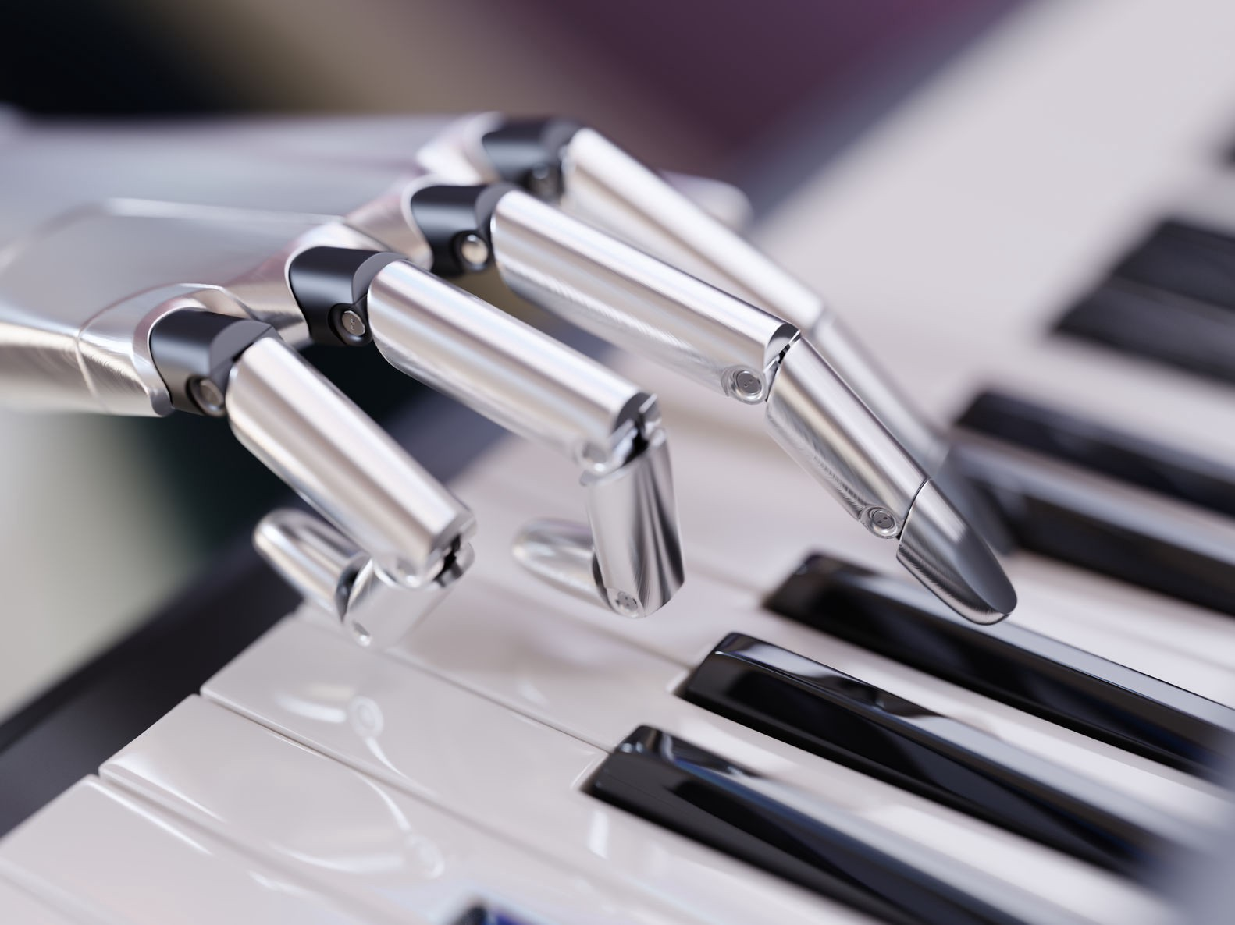
AI Music Computer

Slide 26
What is Artificial Intelligence?
According to Elaine Rich and Kevin Knight, Artificial Intelligence (AI) is the study of how to make computers/machines do things, which at the moment people do better.
Artificial intelligence (AI) is creation of intelligent machines that work and reacts like humans.

Slide 27
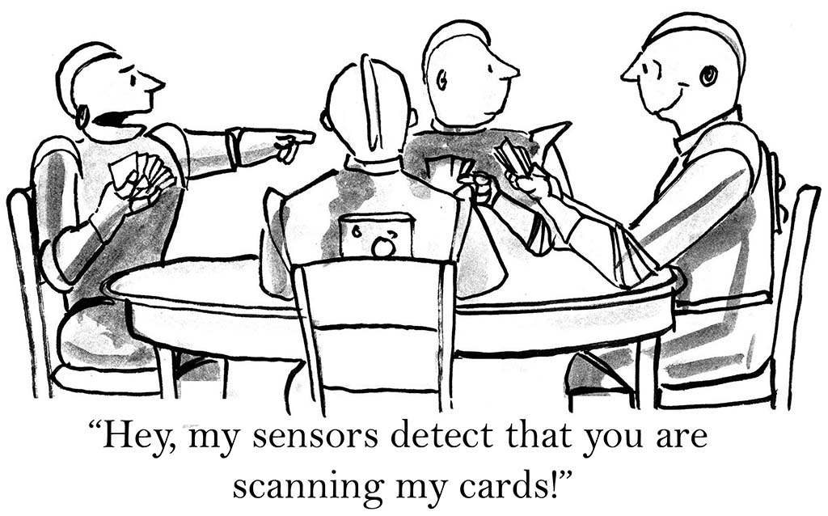

Slide 28
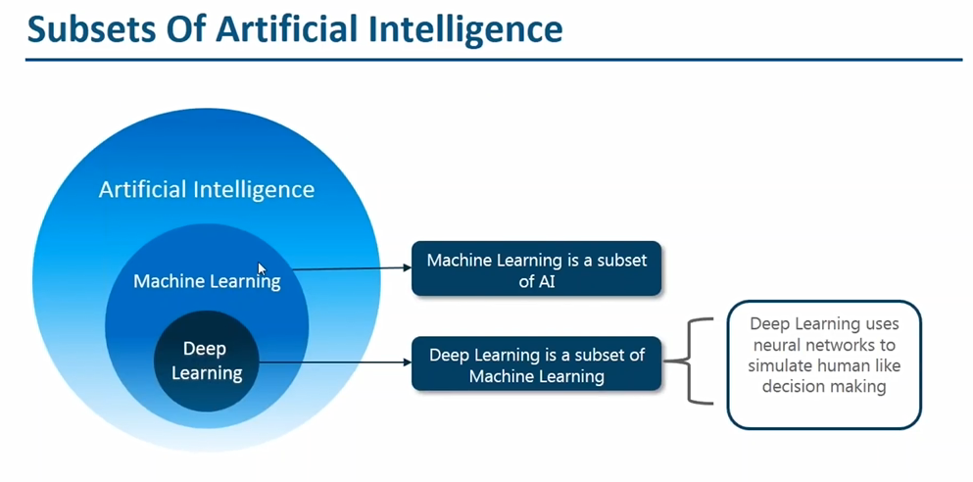

Slide 29
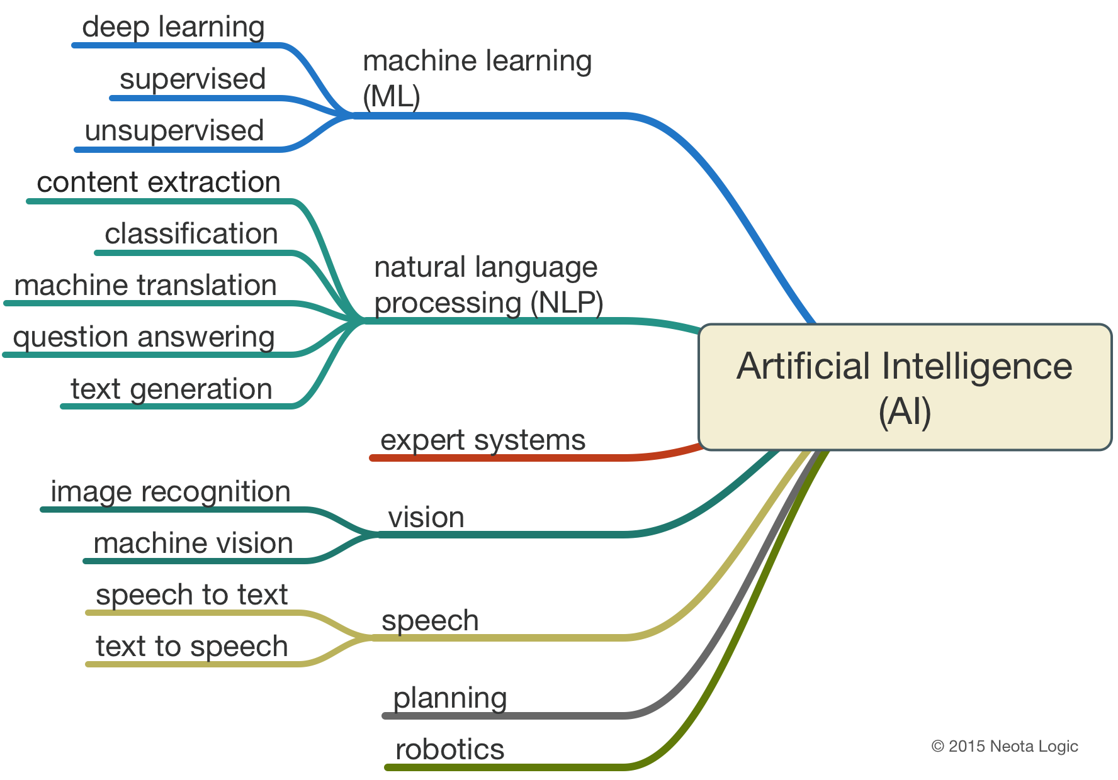

Slide 30
What is Machine Learning ?

Slide 31
What is Learning?
Learning is the process by which a system improves its performance from experience or environment.
It results in change in behavior, knowledge and skills..

Slide 32
What is Machine Learning ?
Machine learning is an application of artificial intelligence (AI) that provides systems the ability to automatically learn and improve from experience without being explicitly programmed.
Machine learning focuses on the development of computer programs that can access data and use it learn for themselves.

Slide 33
How do Machine / Computer Learn?
Computers do the learning process through the following steps :
Data Acquisition of new Knowledge
Problem Solving

Slide 34
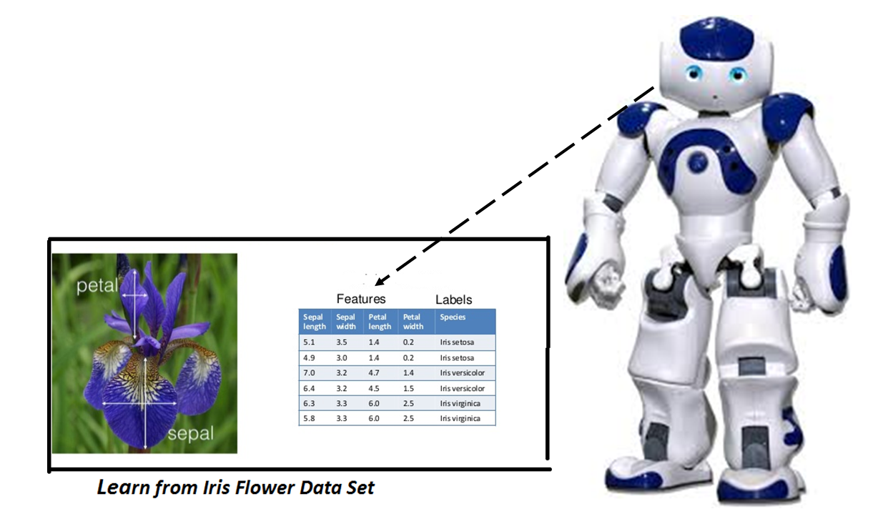
Learning through Data Set

Slide 35
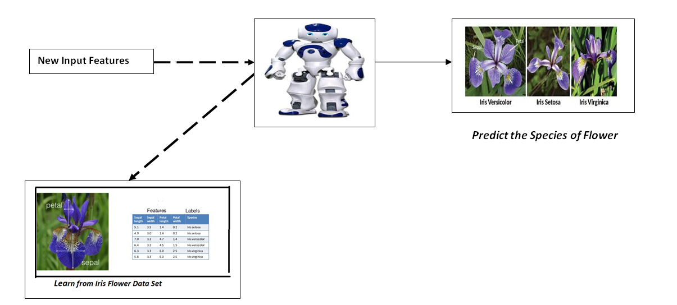
Problem Statement :Determine the Specie Of the Flower

Slide 36
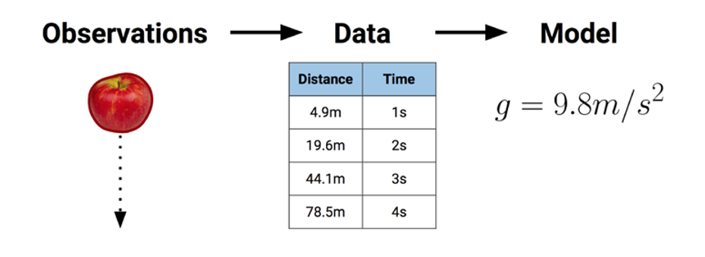

Slide 37
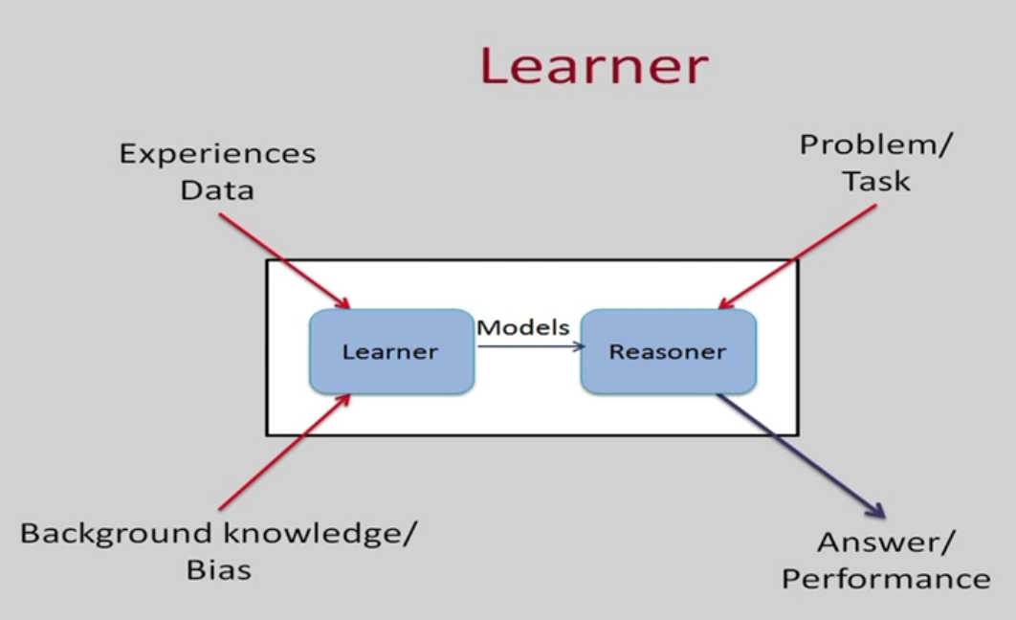

Slide 38
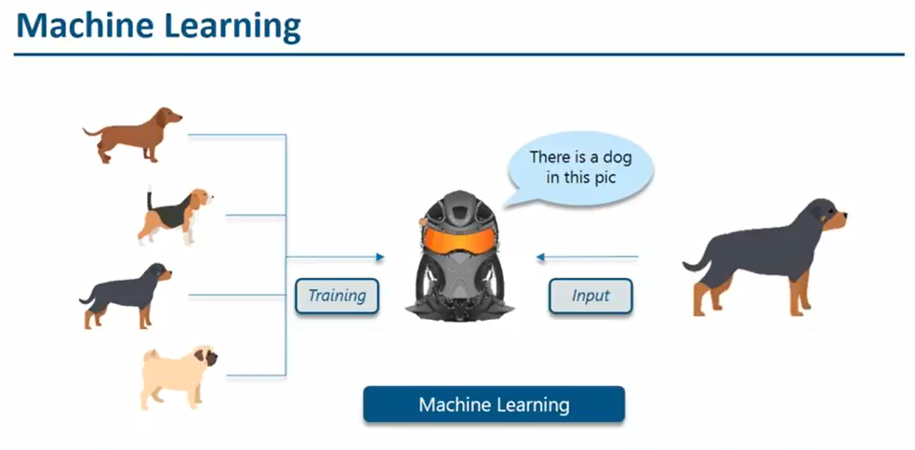

Slide 39
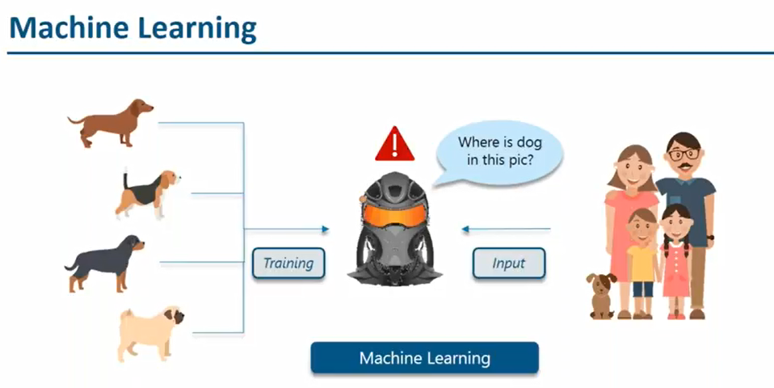

Slide 40
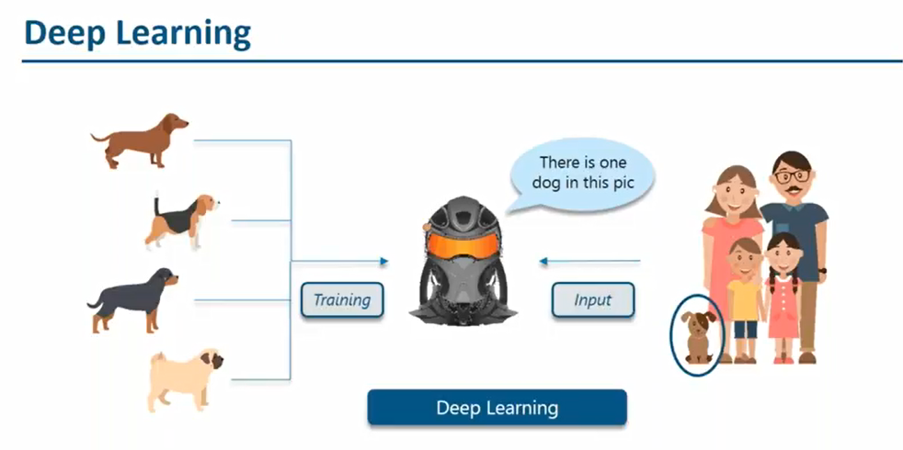

Slide 41
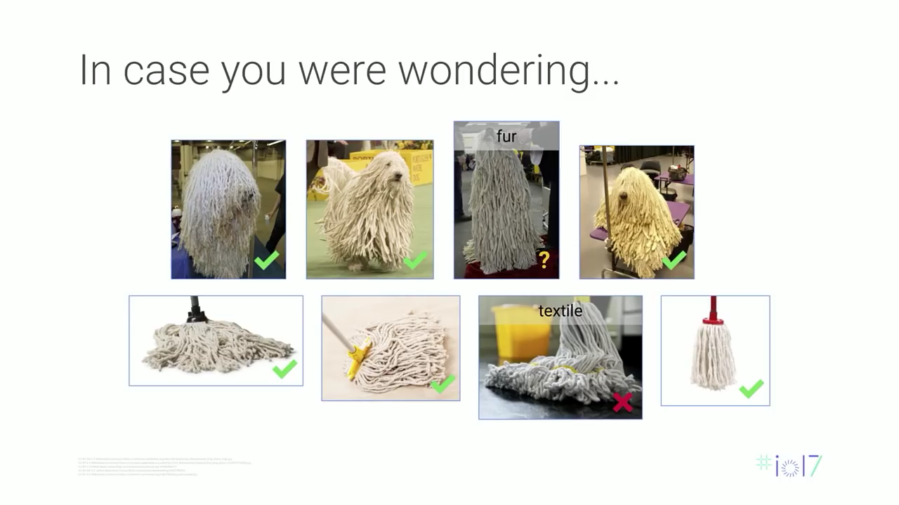

Slide 42
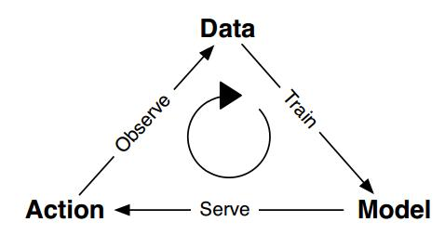
Machine Learning Life Cycle

Slide 43
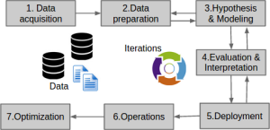
Machine Learning Life Cycle

Slide 44
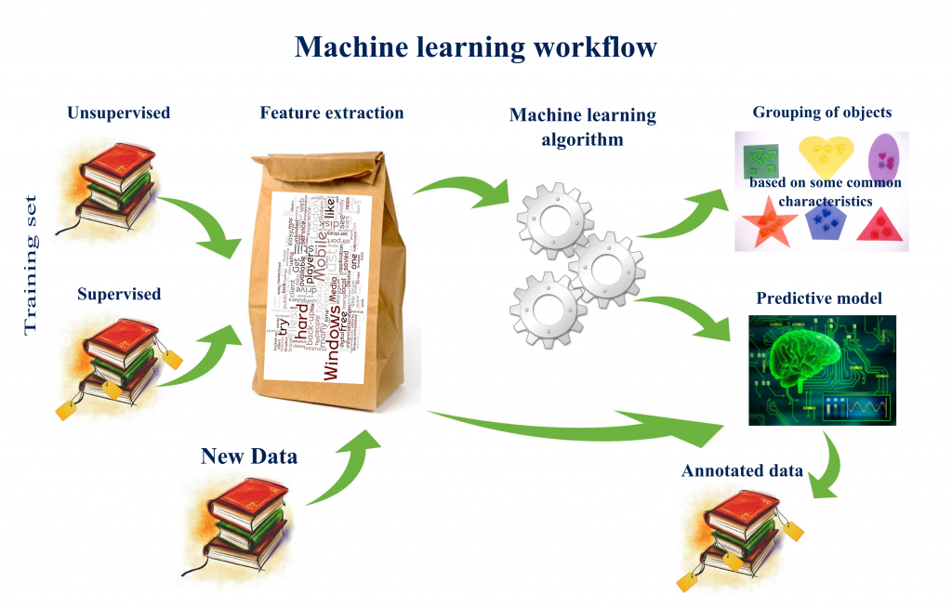

Slide 45
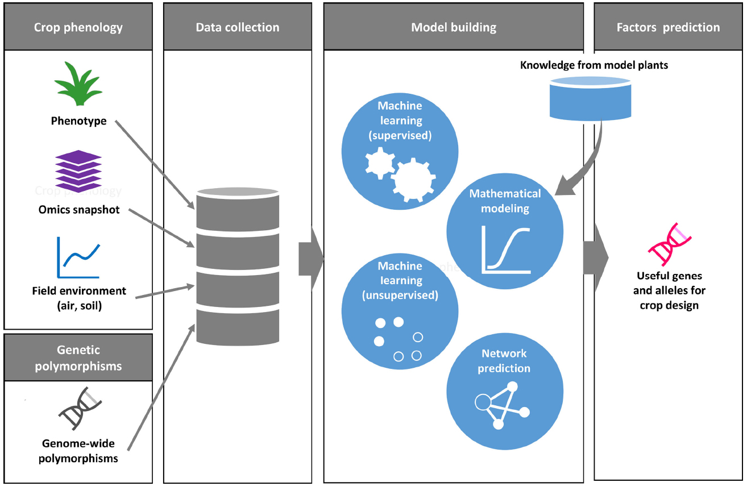
Example

Slide 46
Types of Machine Learning Techniques
Shallow Learning
Algorithms with Few Layers
Better for Less Complex and Smaller Data sets
Eg: Logistic Regression and Support vector Machines
Deep Learning
New technique that uses many layers of neural network ( a model based on the structure of human brain)
Useful when the target function is very complex and data sets are very large.

Slide 47
Classification of Machine Learning
Supervised Learning
X and Y
Given an observation X what is the best label for Y
Unsupervised Learning
X
Given a set of X cluster or summarize them
Semi Supervised Learning
Reinforcement Learning
Determine what to do based on Rewards and punishments

Slide 48
1. Supervised Learning
Here the training (labeled) data set containing input/predictors and output will be fed to the machine. The machine with the help of algorithm analyze the data set and generates a suitable model /function that best describes the input data. i.e it generates a function f(X) which makes best estimation of the output X for given X.
The generated model / function can be used to predict the output values for new data based on those relationships which it learned from the previous data sets.
When Y is discrete (True /False, ..) – Classification
When X is continuous (Real Numbers )- Regression

Slide 49
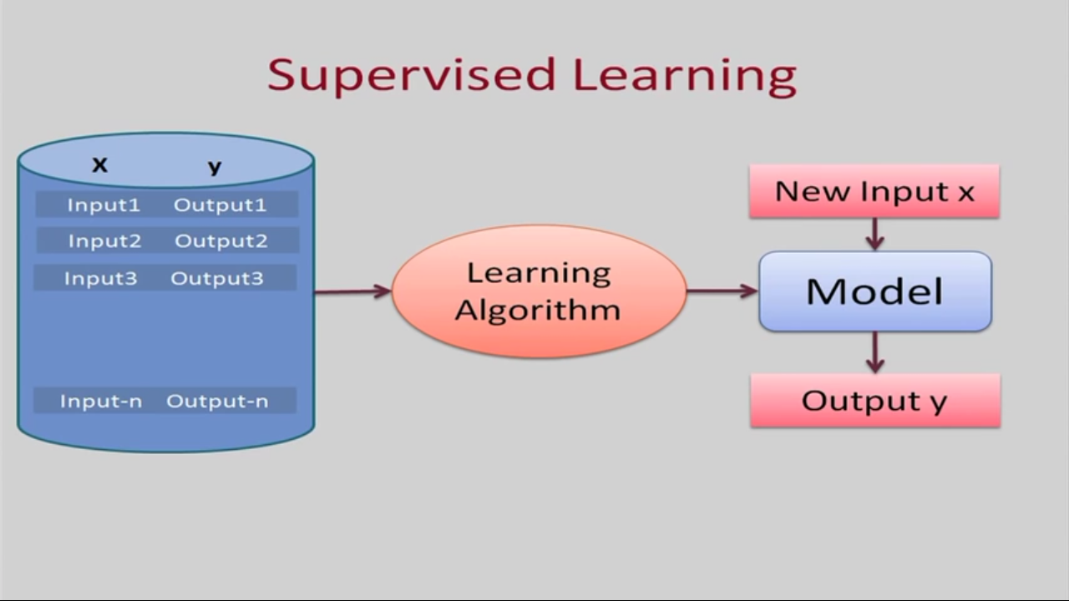

Slide 50
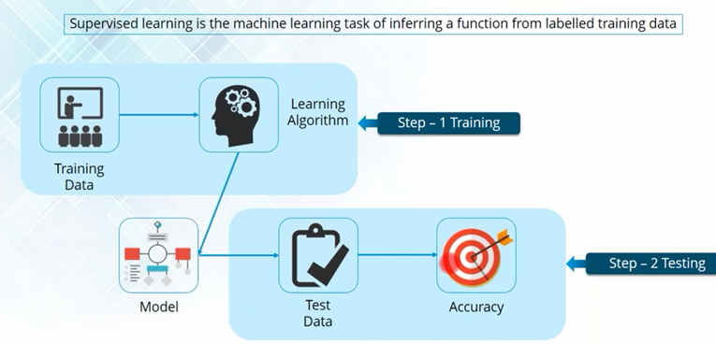

Slide 51
Types of Supervised Learning (Task Driven . Develop Prediction Model based on Input and Output Data)
Classification ( Discrete)
Logistic Regression
KNN
Decision Trees
Support Vector Machines
Naïve Bayesian
Discriminant Analysis
Random Forest
AdaBoost
Neural Networks
Regression ( Continuous)
Linear Regression
SVR
GPR
Ensemble Methods

Slide 52
Real time Applications
An e-mail message is spam
A person has cancer
A football team will win or lose
An applicant will default on a loan
Predicting how much money a user will spend in a shop based on his characteristic
Predicting power consumption in the next month
Predicting stock prices
With bunch of photos with information what is on them and one train a model to recognize new photos
With bunch of molecules and information which are drugs and one can train a model to answer whether new molecule is also a drug.

Slide 53
2. Unsupervised Learning
This approach is data driven . The computer is trained with unlabeled input data.
These algorithms try to use techniques on the input data to mine for rules, detect patterns, and summarize and group the data points which help in deriving meaningful insights and describe the data better to the users.

Slide 54
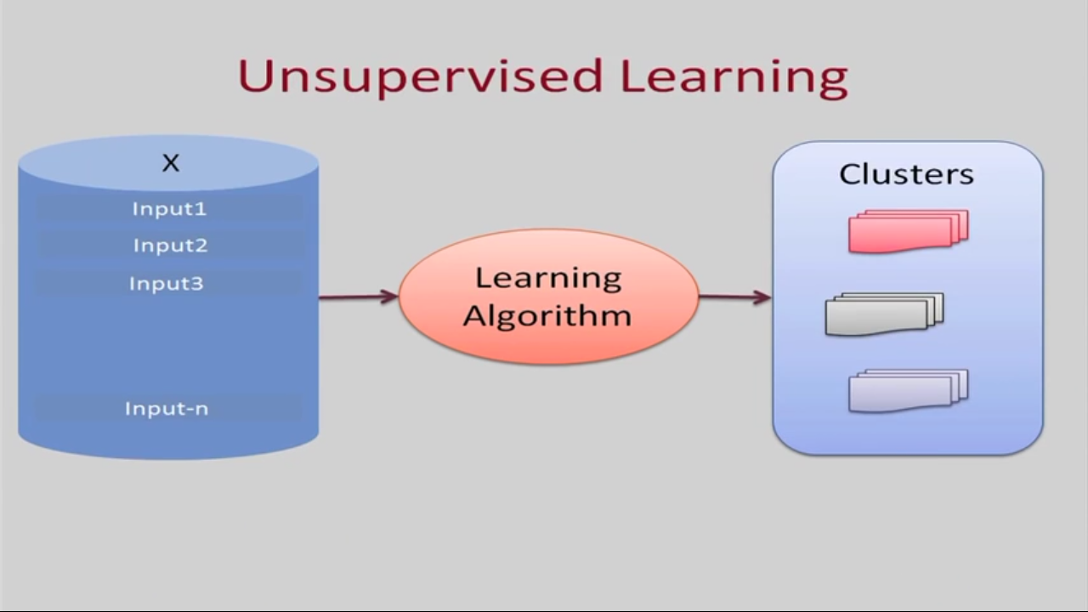

Slide 55
Types of Unsupervised Learning
Clustering
K Means Clustering
Hierarchical Clustering
Gaussian Mixture Models
Genetic Algorithms
Artificial Neural Networks
Dimensionality Reduction
Tensor Decomposition
Principal Component Analysis
Multidimensional statistics
Random Projection
Artificial Neural Networks
Association Rules

Slide 56
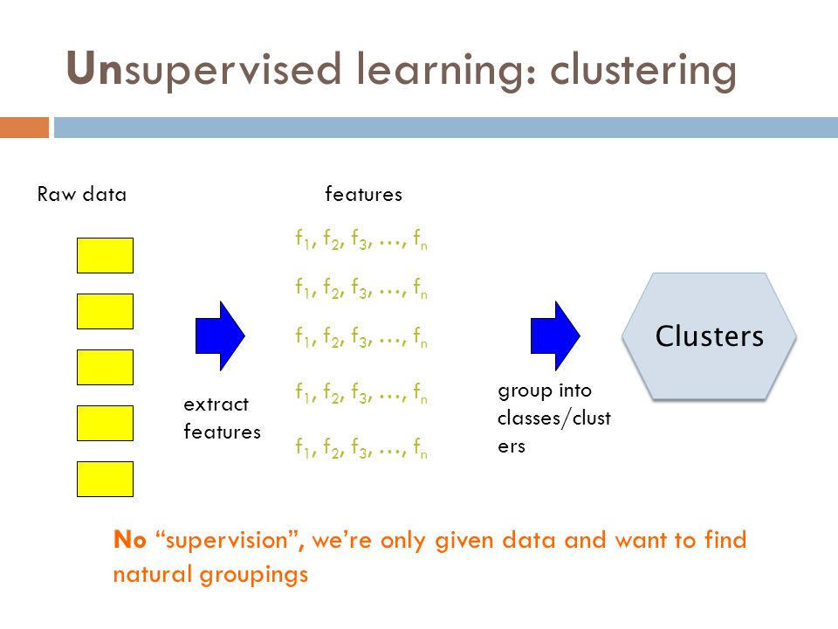

Slide 57
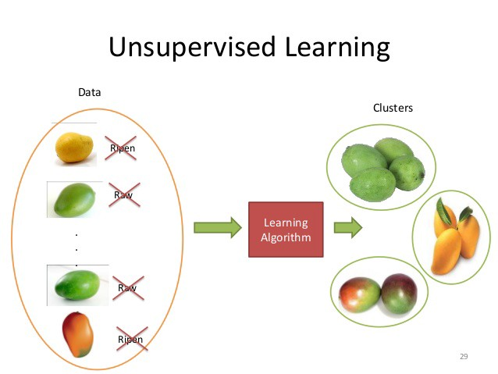

Slide 58
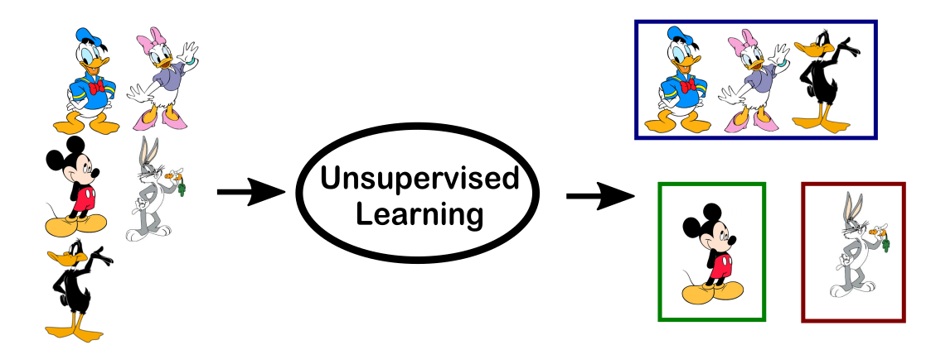

Slide 59
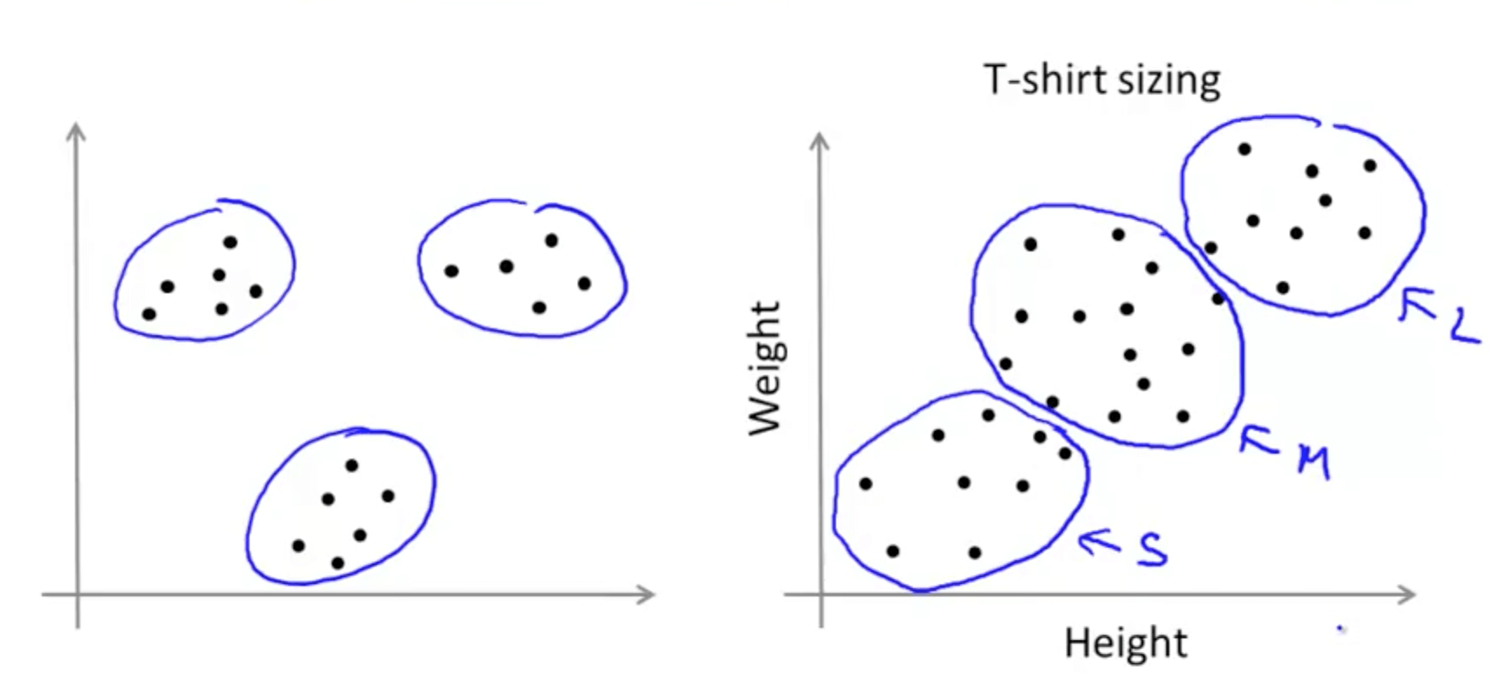

Slide 60
Use Cases / Real Life Examples
Given set of images of stars, do they form some distinguishable types of stars?
Given users activity on our website - are there distinguishable usage scenarios that we can find?
such as grouping customers by purchasing behavior
such as people that buy X also tend to buy Y

Slide 61
3. Semi Supervised
In the previous two types, either there are no labels for all the observation in the dataset or labels are present for all the observations.
Semi-supervised learning falls in between these two.

Slide 62
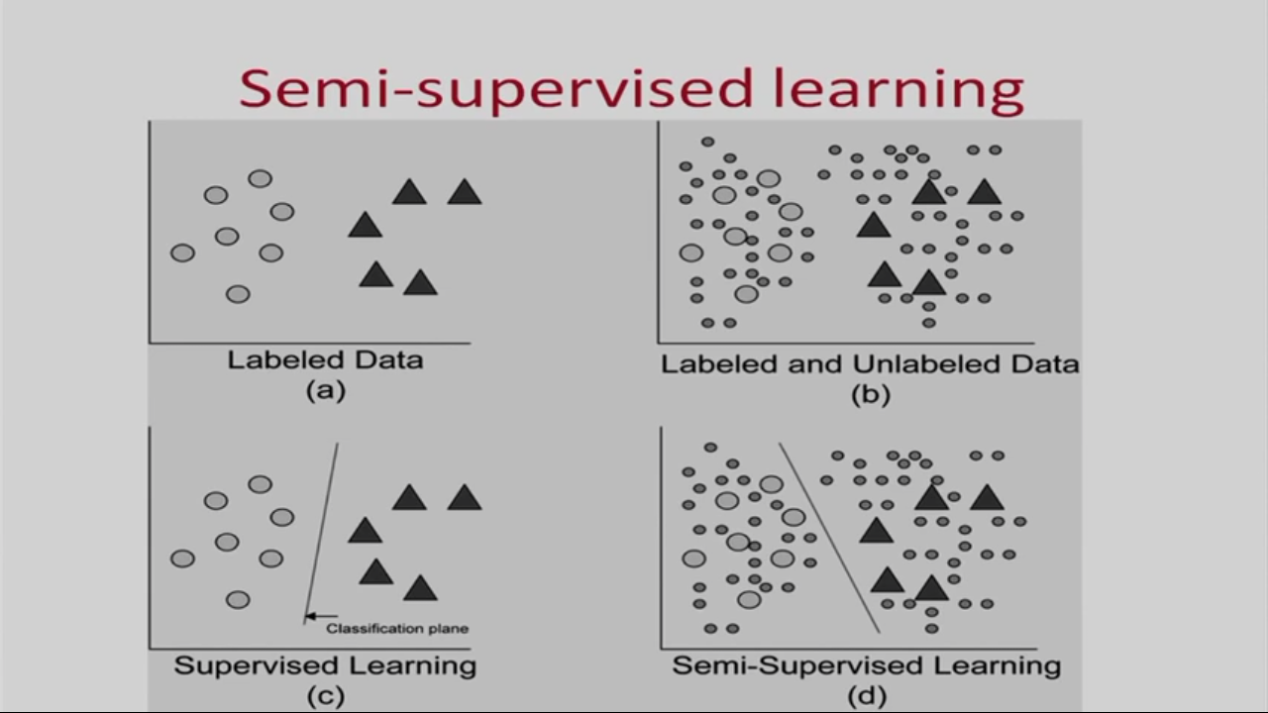

Slide 63
Types
Co Training
Self Training

Slide 64
Applications
One real world application for semi-supervised learning, is webpage classification. Say you want to classify any given webpage into one of several categories (like "Educational", " Shopping", "Forum", etc.).
Protein function prediction using sequence

Slide 65
4. Reinforcement Learning
This method aims at using observations gathered from the interaction with the environment to take actions that would maximize the reward or minimize the risk.
Reinforcement learning algorithm (called the agent) continuously learns from the environment in an iterative fashion.
In the process, the agent learns from its experiences of the environment until it explores the full range of possible states.

Slide 66


Slide 67
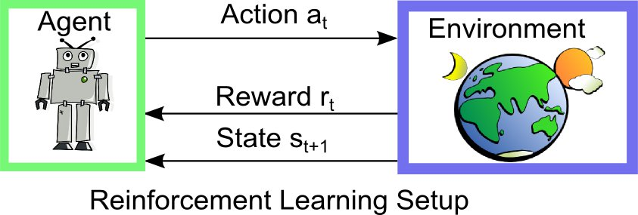

Slide 68
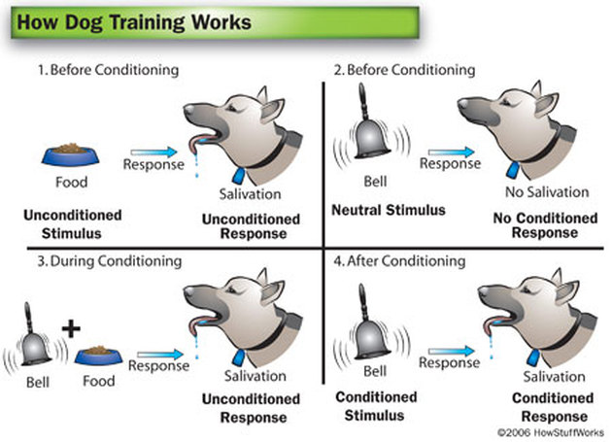

Slide 69
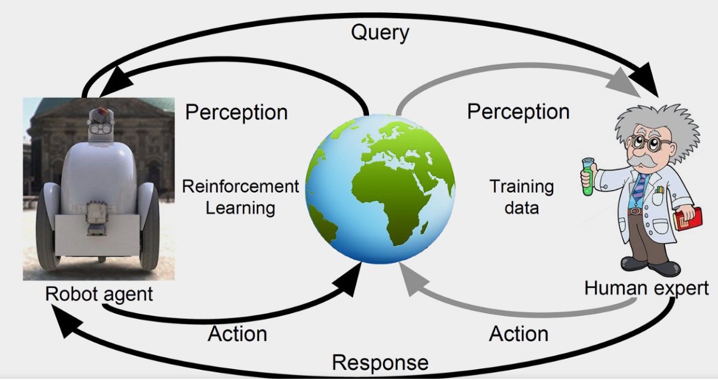

Slide 70
Use cases
Some applications of the reinforcement learning algorithms are computer played board games (Chess, Go), robotic hands, and self-driving cars.
Manufacturing : a robot uses deep reinforcement learning to pick a device from one box and putting it in a container. Whether it succeeds or fails, it memorizes the object and gains knowledge and train’s itself to do this job with great speed and precision.

Slide 71
Types of Reinforcement Learning Algorithms
Q-Learning
Temporal Difference (TD)
Deep Adversarial Networks

Slide 72
Terminologies
Labeled data: Data consisting of a set of training examples, where each example is a pair consisting of an input and a desired output value (also called the supervisory signal, labels, etc)
Classification: The goal is to predict discrete values, e.g. {1,0}, {True, False}, {spam, not spam}.
Regression: The goal is to predict continuous values, e.g. home prices.

Slide 73
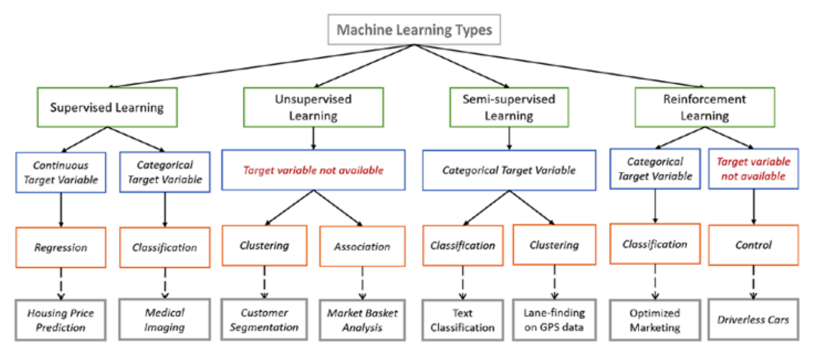

Slide 74
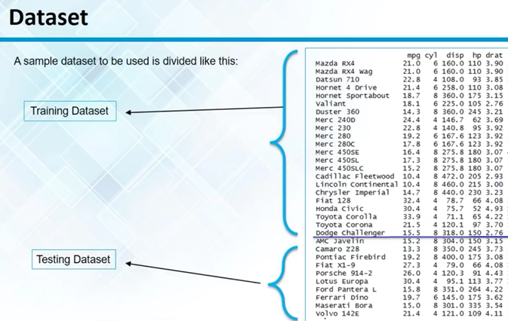

Slide 75
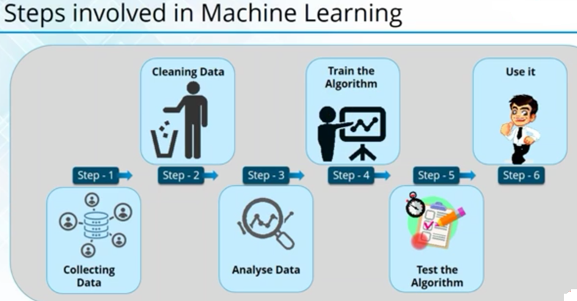

Slide 76


Slide 77


